Slide 1

GPS Tracking System and Monitoring Peripherals (An IOT and WEB development project)
DEVELOPED AT :
TATA TECHNOLOGIES LTD.
SUBMITTED BY:
Akshay Vinayak, Tripti Mishra, Saurav Raj, Manisha Singh
K.Riya, Rahul Nayyar, Priyal Pandey, Arpita Mitra, Divya Suman, Avinash Kumar
(Computer Science & Engineering Department)

Slide 2
What is IOT?
The Internet of Things (IOT) is many things to many people. It means a fundamental change in the way mobile network operators, build and manage networks to remain profitable.
The Internet of Things (IOT) is the network of physical devices, vehicles, home appliances and embedded with electronics, software, sensors, actuators, and connectivity which enables these things to connect and exchange data creating opportunities for more direct integration of the physical world into computer-based systems, resulting in efficiency improvements, economic benefits and reduced human intervention.

Slide 3
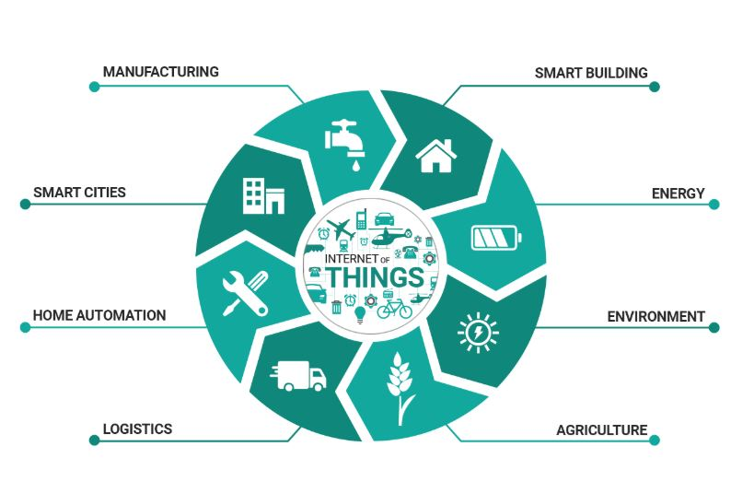
Why IOT?

Slide 4
Introduction Of Project
The device is turned On.
Device throws the IP address for showing the output by the GPS module.
GPS tracks the vehicle speed and location.
Efficiency of components are tracked via server.
Output also gives the link to site from where we proceed the tracking over cloud.
Hence this insures safety for the vehicles that are on fields for testing and that the components are working fine.

Slide 5
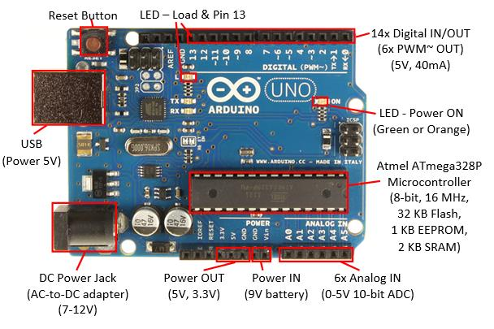
Components Used-
Arduino UNO Board:

Slide 6
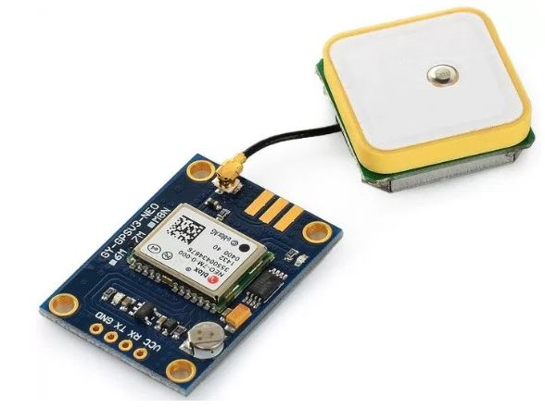
GPS Module:

Slide 7
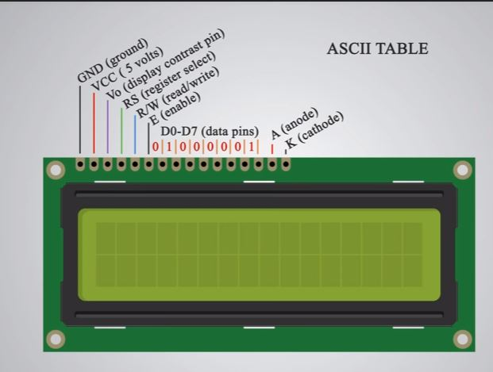
LCD Module:

Slide 8
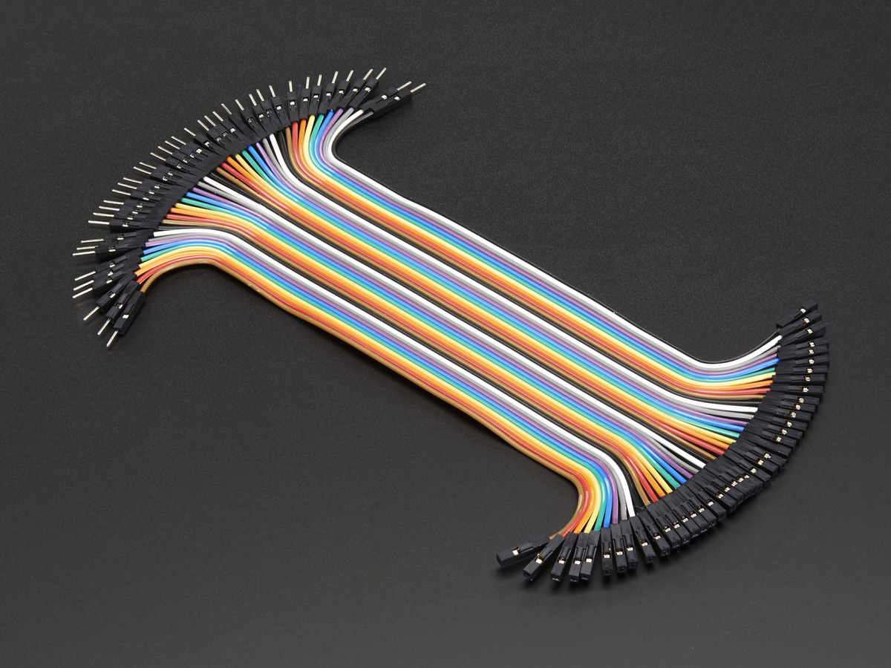
Jumper Wires:

Slide 9
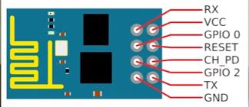
Wi-Fi Module :

Slide 10
Program DESCRIPTION:
The program deals with all the components installed i.e. Arduino Board, LCD Module, GPS Module, Wi-Fi shield according to their functions written. LCD Module displays all the connection data and the coordinates as per requirement; where as GPS Module gives the location of the vehicle. Now WIFI shield is installed so that we can connect the device to the cloud and get the instant data anytime anywhere, WIFI shield helps throw the IP address of the system in which it is installed so as to visit the web address. All these components are programmed over the Arduino UNO board. Hence the GPS Tracking System is ready to serve the needs of people.

Slide 11
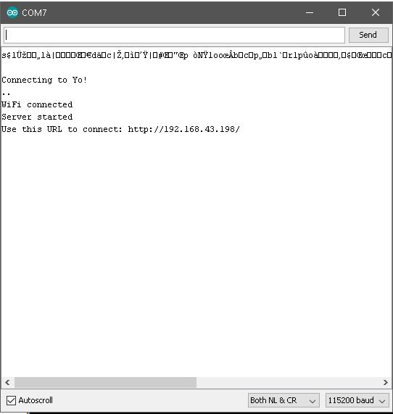
Output-

Slide 12
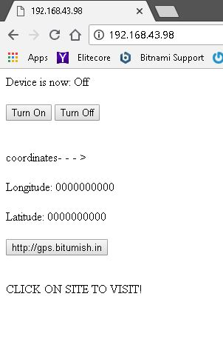

Slide 13
Web interfacing

Slide 14
Introduction to hardware and software
Hardware Requirements
A Server
Systems for Monitoring
Software Requirements
C Panel to configure hosting and server.
Latest Version of the OS.
PHP for monitoring and maintaining the web interface.
MySQL for monitoring and maintaining the database.

Slide 15
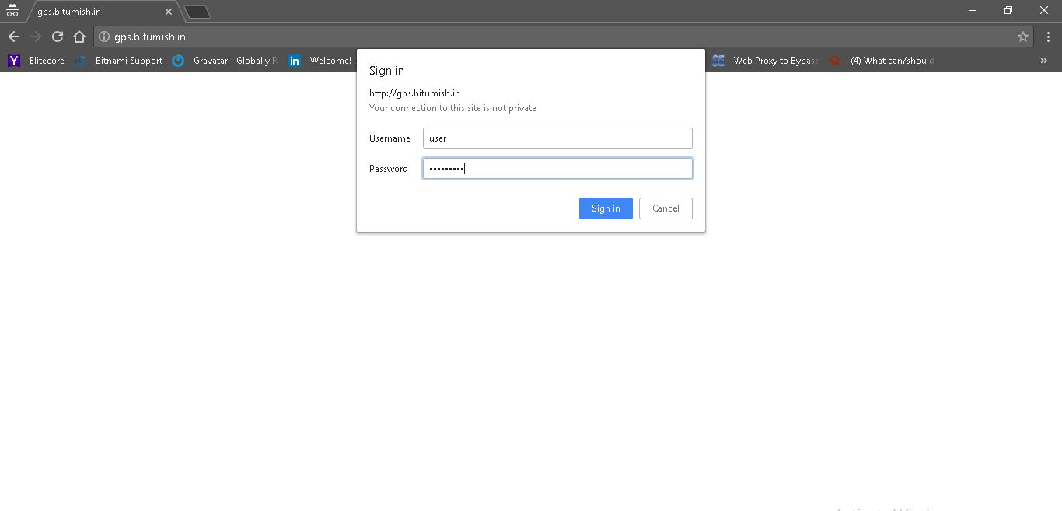
WEBSITE
LOGIN PAGE

Slide 16
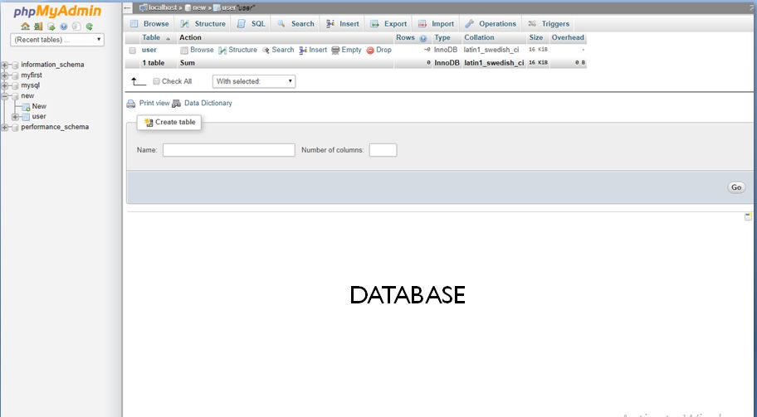

Slide 17
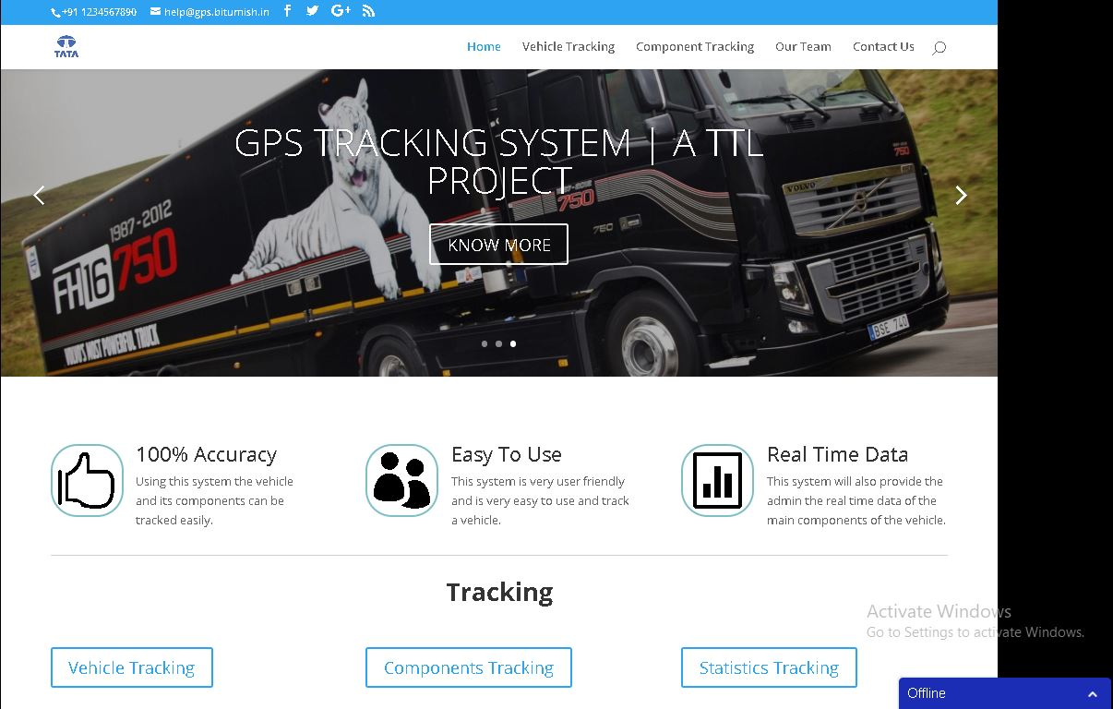
HOMEPAGE

Slide 18
VEHICLE TRACKING
Here we have used GPS technology for locating the vehicle. Vehicle information can be viewed on electronic maps via the Internet on our website. We can also analyze the speed of different vehicles and also compare them,

Slide 19
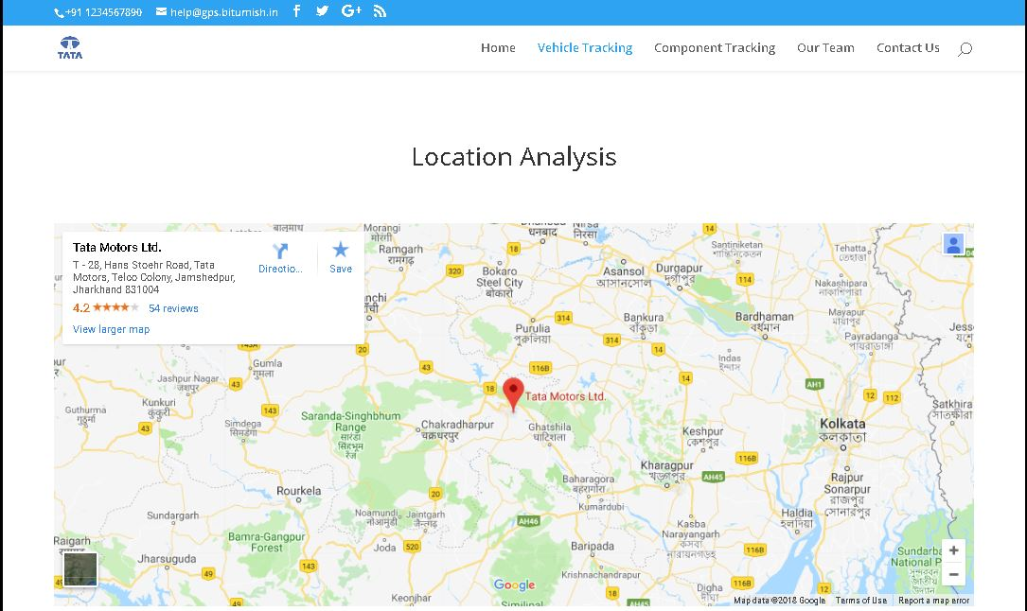
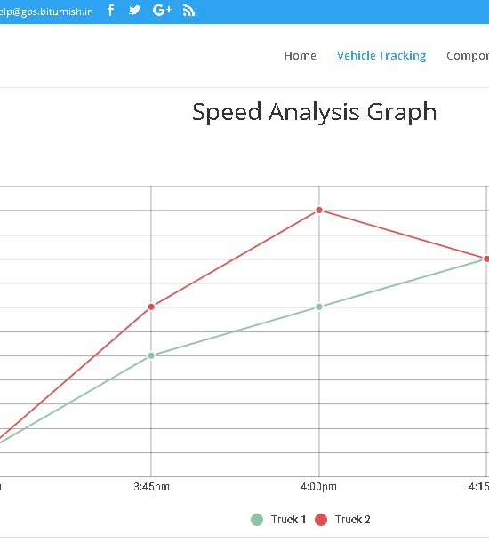
LOCATION ANALYSIS
SPEED ANALYSIS

Slide 20
COMPONENTS TRACKING
This module will help us track the components of the truck we are tracking.
Real time data of the components will be available.
Will help in improving the quality of the components that are being manufactured.
Any wear and tear or even a malfunction can be tracked easily.

Slide 21
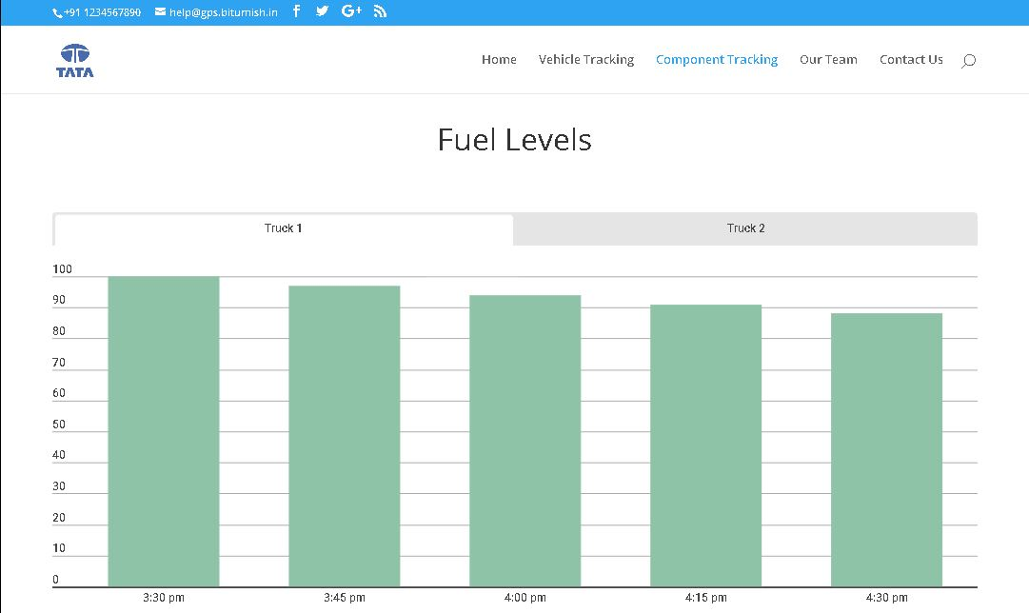
FUEL TRACKING

Slide 22
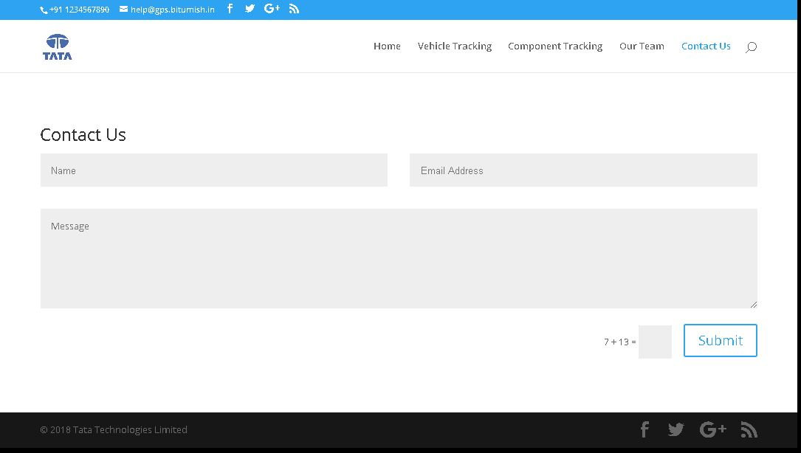
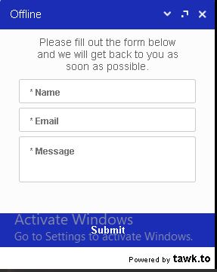
CONTACT US
ONLINE

Slide 23
Disadvantages:
An Arduino is a microcontroller motherboard. A microcontroller is a simple computer that can run one program at a time.
Device cannot operate upon harsh weather conditions as there can be server lag, less signal strength.
Loose connection was one of the major problems which we faced while working for this project. It was very difficult to identify which wire was having loose connection

Slide 24
Advantages:
Reducing fuel costs
Improving driver behavior
Increasing safety and security
Best customer service
Importance of mapping
Using reports and alerts

Slide 25
THANK YOU

